Slide 1
Hello Reception Parents & Carers
Phonics & Reading
Information Evening
4th November 2025

Slide 2
What is Phonics?
A method of teaching children to read, where they learn the relationship between sounds and the spellings that represent them.

Slide 3

At North Bradley, we follow the Sounds~Write scheme of First Rate Phonics.
The scheme is made up from an initial code and extended code.

Slide 4
Initial code
This is made up of units 1-11, covering sounds that can represented by 1 letter.
It also covers VCC up to CCCVC words.
It reaches unit 11, with some diagraphs – 2 letters one sound representations e.g. ‘sh’ & ‘ch’
https://www.youtube.com/watch?v=a8ZMfYjdN-s&list=PLtkXxHM4IBSyBmj589aD6S5THkIqedJVx&index=6

Slide 5
Extended code
This covers many vowel diagraphs throughout year 1, such as ‘ai’ as well as many alternative diagraphs such as ‘ay’ or ‘a-e’.
As children reach year 2 they will encounter more alternatives of these sounds, such as ‘ey’ or ‘eigh’ these represent different spellings.

Slide 6
Initial & Extended code continued…
Children will see the alternative spellings in various ways depending on the skill they are practising.
Including;
seeking sounds in stories
organising words into sounds groups
blending and segmenting
building words with new focus phoneme
Write dictated sentences including various phonemes

Slide 7
The skills
Blending – push sounds together to build words.
c a t cat

Slide 8
Segmenting – pull apart sounds in words.
jump j u m p

Slide 9
Phoneme manipulation – ability to insert sounds and delete sounds out of words.
log – og
log - blog

Slide 10

Overview
Key Stage One
Polysyllabic Words
cou|pon, win|dow, ha|ppy, a|ma|zing
The Extended Code
  1 sound different spellings: pain, break, play, cake
  1 spelling different sounds: break, dream, head
Reception
Key Stage Two
a i m s t, n o p, b c g h, d f e v, k l r u, j x w, z y
ff ll ss zz, sh, th, ch, ng, qu, wh, le
o|ffi|cial, spe|cial, ar|ti|fi|cial,
con|fi|den|tial, e|ssen|tial
CVC – sat, nap, bag
VCC – end, and
CVCC – must, jump
CCVC – stop, trick
CCVCC – stump, print
CCCVC – scrap

Slide 11
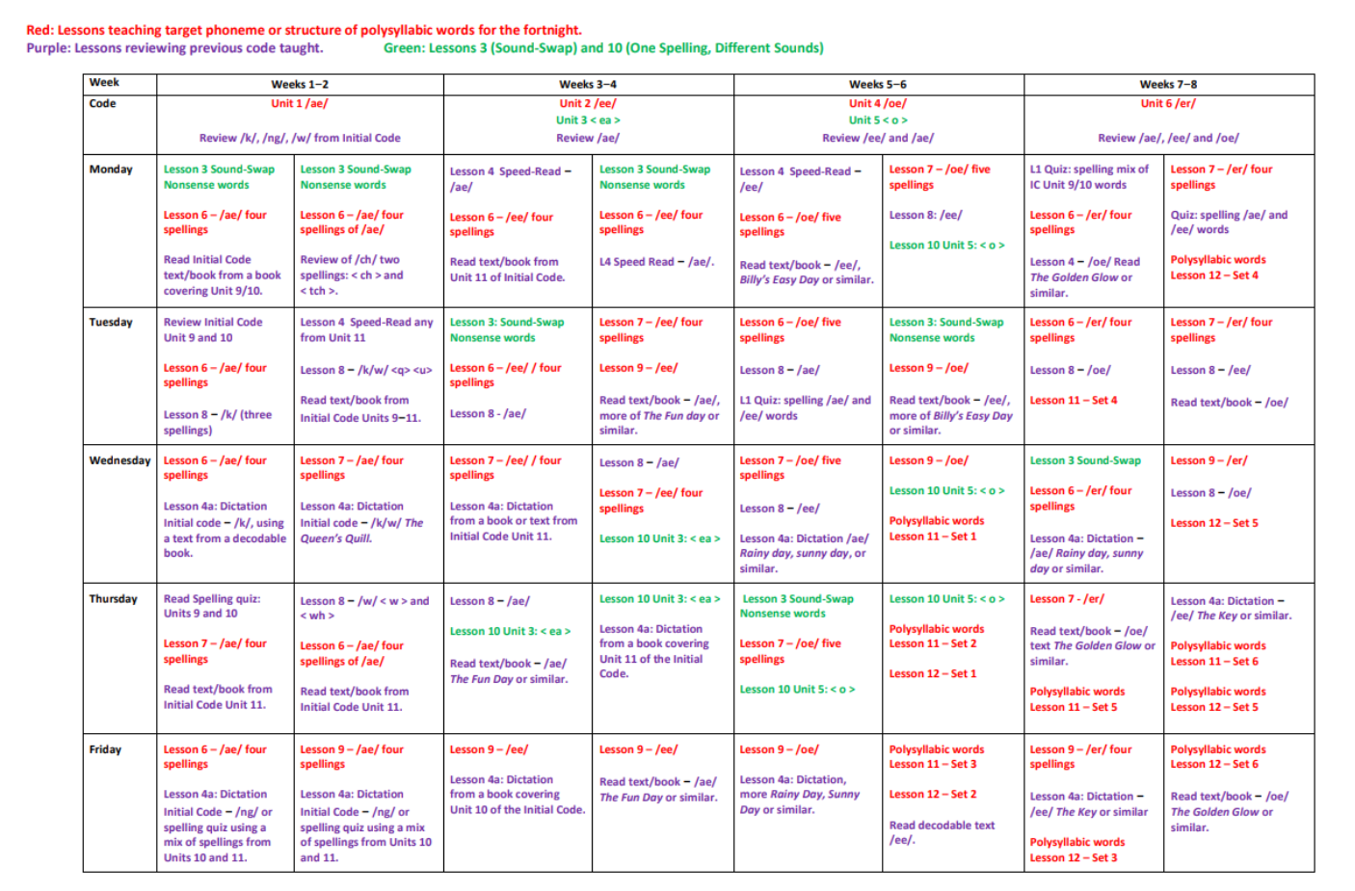

Slide 12


Our reading scheme
Books progress matching our phonics teaching – these will be decodable (can use phonics to read)
Please look after these ☺
Please also note children may read these books more than once

Slide 13
Reading at home
We ask children read their books daily.
Once to decode by practise blending and segmenting.
Twice for prosody and fluency.
Third for comprehension and expression.
3 times is essential!

Slide 14
Things to remember!
Books will be changed by the class teacher, by monitoring their progress and matching books to their phonic knowledge.
Your child will be given a reading record with their book, please make sure you record in the reading record when you have read with your child so we know they have been reading.
Books will be changed on a Monday and Thursday – Please make sure they are always in your child's book bag.
Teachers will stamp acknowledging that you have read with your child.
Your comments are helpful and lovely to read!

Slide 15
Reading Races
Please use our reading races to encourage your child to read, sign off one circle EVERY TIME your child reads, once you have five completed, they will receive a book prize.
These will be tucked into your reading records and numbered.

Slide 16
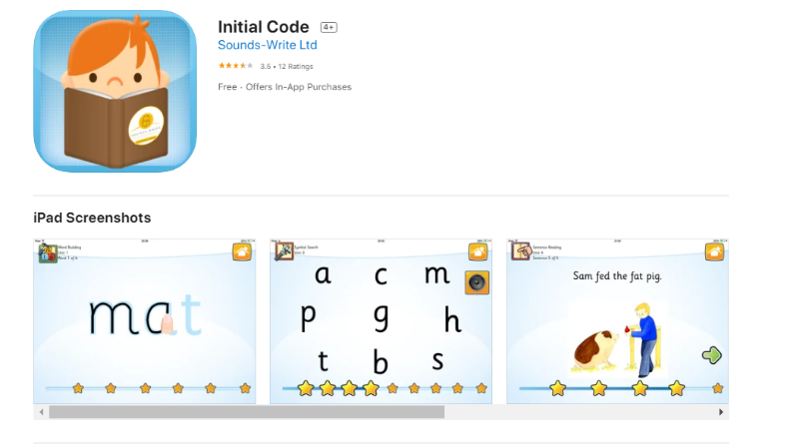
Initial code app

Slide 17

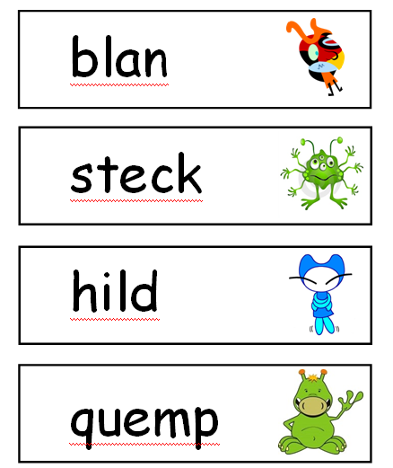
Year 1 Phonics Screening

Slide 18
How can you help?
2 letters that make 1 sound = shop
Have fun blending & segmenting
Read, read, read
Encourage discussion around what sounds/graphemes they notice
Encourage children if they are unsure to ALWAYS ‘say the sound and read the word’
Encourage independence by asking children to use their finger to support tracking

Slide 19

https://sounds-write.co.uk/support-for-parents-and-carers/

Slide 20
?

