Slide 1
Phonics & Reading
Information Evening
28th September 2023

Slide 2
What is Phonics?
A method of teaching children to read, where they learn the relationship between sounds and the spellings that represent them.

Slide 3
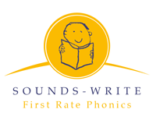
At North Bradley, we follow the Sounds~Write scheme of First Rate Phonics.
The scheme is made up from an initial code and extended code.

Slide 4
Initial code
This is made up of units 1-11, covering sounds that can represented by 1 letter.
It also covers VCC up to CCCVC words.
It reaches the end of reception, with some diagraphs – 2 letters one sound representations.

Slide 5
Extended code
This covers many vowel diagraphs throughout year 1, such as ‘ai’ as well as many alternative diagraphs such as ‘ay’ or ‘a-e’.
As children reach year 2 they will encounter more alternatives of these sounds, such as ‘ey’ or ‘eigh’ these represent different spellings.

Slide 6
Initial & Extended code continued…
Children will see the alternative spellings in various ways depending on the skill they are practising.
Including;
seeking sounds in stories
organising words into sounds groups
blending and segmenting
building words with new focus phoneme
Write dictated sentences including various phonemes

Slide 7
The skills
Blending – push sounds together to build words.
c a t cat

Slide 8
Segmenting – pull apart sounds in words.
jump j u m p

Slide 9
Phoneme manipulation – ability to insert sounds and delete sounds out of words.
log – og
log - blog

Slide 10

Overview
Key Stage One
Polysyllabic Words
cou|pon, win|dow, ha|ppy, a|ma|zing
The Extended Code
  1 sound different spellings: pain, break, play, cake
  1 spelling different sounds: break, dream, head
Reception
Key Stage Two
a i m s t, n o p, b c g h, d f e v, k l r u, j x w, z y
ff ll ss zz, sh, th, ch, ng, qu, wh, le
o|ffi|cial, spe|cial, ar|ti|fi|cial,
con|fi|den|tial, e|ssen|tial
CVC – sat, nap, bag
VCC – end, and
CVCC – must, jump
CCVC – stop, trick
CCVCC – stump, print
CCCVC – scrap

Slide 11
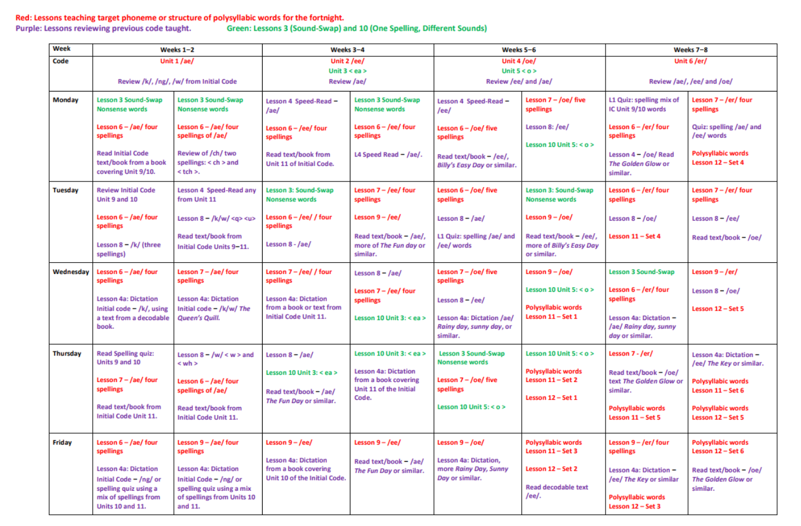

Slide 12
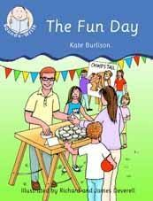
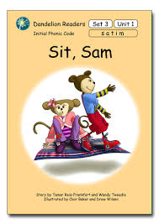
Our reading scheme
Books progress matching our phonics teaching – these will be decodable (can use phonics to read)
Please look after these ☺
Please also note children may read these books more than once

Slide 13
Reading at home
Children should read books 3 times.
Once to decode by practise blending and segmenting.
Twice for prosody and fluency.
Third for comprehension and expression.
This is essential!

Slide 14
Things to remember!
Books will be changed by the class teacher, by monitoring their progress and matching books to their phonic knowledge.
Your child will be given a reading record with their book, please make sure you record in the reading record when you have read with your child so we know they have been reading.
Books will be given out and collected in on a Monday and Friday – Please make sure they are always in your child's book bag.
Teachers will stamp acknowledging that you have read with your child.
Your comments are helpful and lovely to read!

Slide 15
Reading Races
Please use our reading races to encourage your child to read, sign off one circle EVERY TIME your child reads, once you have five completed, they will receive a book prize.
These will be tucked into your reading records and numbered.

Slide 16
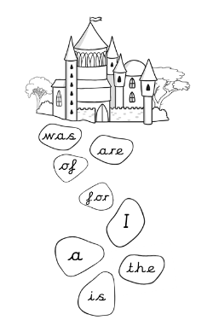
High frequency words
Children will also need to practise their high frequency words at home.
We practise these daily.
If you are confident your child knows the words you can colour it in once completed they can colour the castle.
The next sheet will be given out next term.
Children will be assessed on these at school to monitor their progress.
Note * these appear in reading books.

Slide 17
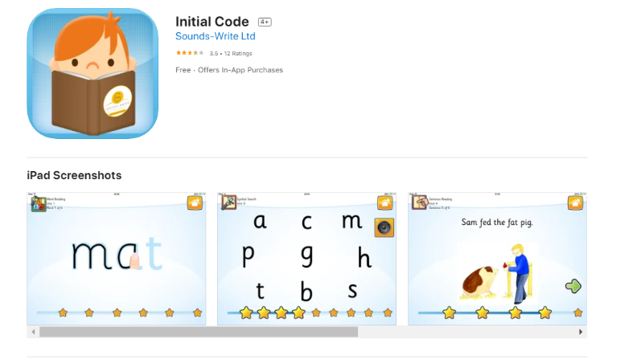
Initial code app

Slide 18
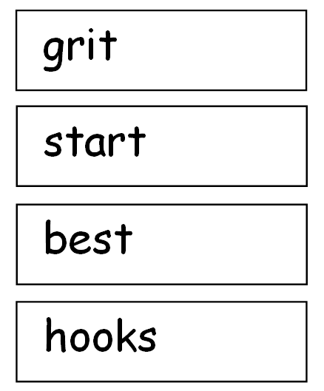
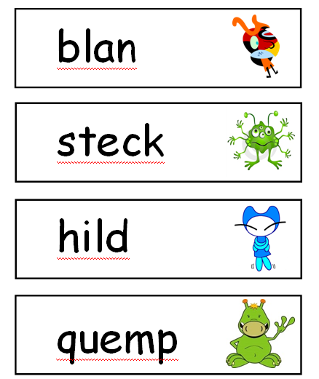
Year 1 Phonics Screening

Slide 19
Importance of talk
Children from ‘talk a lot’ families have heard 33 million words by the age of 3 and will have had 1700 hours of stories.
Children from ‘not talk a lot’ families have only heard 9 million words by the age of 3 and will have only had 25 hours of stories.

Slide 20

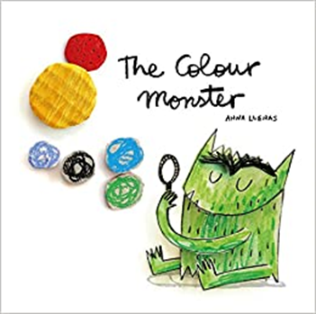
‘Real’ books
Did you know that being read to is the most powerful predictor of your child’s future reading comprehension?
As well as practising with decodable books, being read to is also really important for your child to develop a love of reading and to increase their vocabulary.

Slide 21
When you read to your child you give them:
Your attention
Time to chat
Make it feel like a treat – enjoy the time together
Don’t ask questions to test what they remember
Read their favourite stories again and again
Get them to join in with the bits they remember
Read with enthusiasm, try out different voices

Slide 22
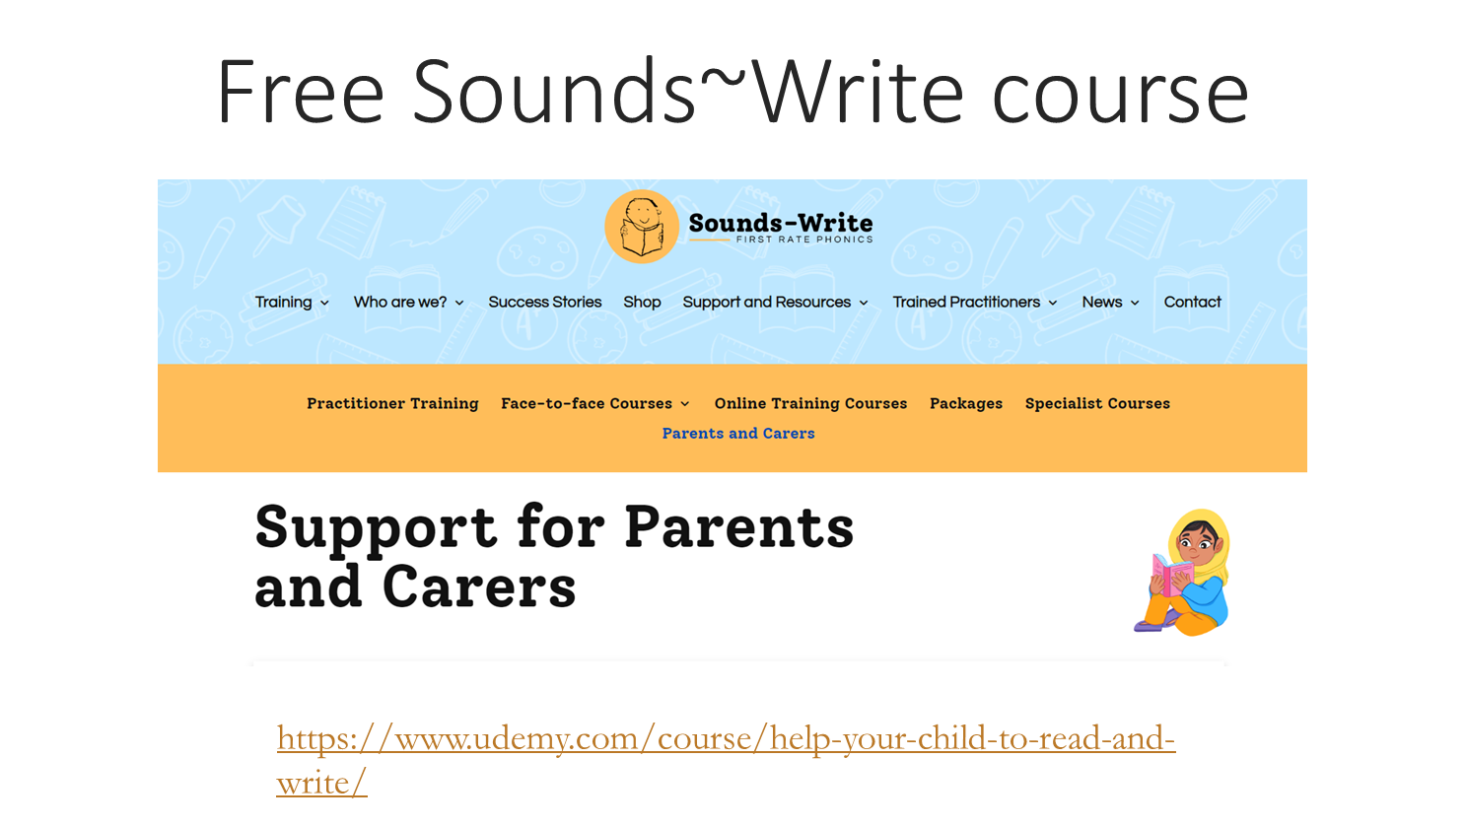

Slide 23
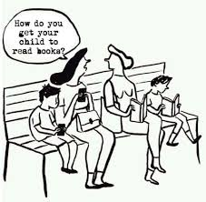

Slide 24
?

