Slide 1

Phonics a little reminder…
A method of teaching children to read, where they learn the relationship between sounds and the spellings that represent them.
The scheme is made up from an initial code and extended code.

Slide 2
Initial code
This is made up of units 1-11, covering sounds that can represented by 1 letter.
It also covers VCC up to CCCVC words.
It reaches the end of reception, with some diagraphs – 2 letters one sound representations.

Slide 3
Extended code
This covers many vowel diagraphs throughout year 1, such as ‘ai’ as well as many alternative diagraphs such as ‘ay’ or ‘a-e’.
As children reach year 2 they will encounter more alternatives of these sounds, such as ‘ey’ or ‘eigh’ these represent different spellings.

Slide 4
Year 1 Extended code
Children will see the alternative spellings in various ways depending on the skill they are practising.
Including;
seeking sounds in stories
organising words into sounds groups
blending and segmenting
building words with new focus phoneme
Write dictated sentences including various phonemes

Slide 5

Overview
Key Stage One
Polysyllabic Words
cou|pon, win|dow, ha|ppy, a|ma|zing
The Extended Code
  1 sound different spellings: pain, break, play, cake
  1 spelling different sounds: break, dream, head
Reception
Key Stage Two
a i m s t, n o p, b c g h, d f e v, k l r u, j x w, z y
ff ll ss zz, sh, th, ch, ng, qu, wh, le
o|ffi|cial, spe|cial, ar|ti|fi|cial,
con|fi|den|tial, e|ssen|tial
CVC – sat, nap, bag
VCC – end, and
CVCC – must, jump
CCVC – stop, trick
CCVCC – stump, print
CCCVC – scrap

Slide 6
Unit 1 /ae/, Week 1 | Monday | Tuesday | Wednesday | Thursday | Friday
Review | Lesson 3 (Sound Swap) Nonsense words | Lesson 4 (Reading and Spelling Words) Words: slump, swept, stink, plank Unit 10 | Lesson 3 (Sound Swap) Nonsense words | Lesson 4 (Reading and Spelling Words) Words: scrap, grand, twist, print Unit 10 | Quizzing Words: slam, smell, stop, plum, clip Unit 9
Current unit | Lesson 6 (One Sound, Different Spellings - Word Puzzles) One word for each spelling of /ae/: rain, say, great, make Unit 1 /ae/ | Lesson 6 (One Sound, Different Spellings - Word Puzzles) One word for each spelling of /ae/: pain, way, steak, take Unit 1 /ae/ | Lesson 6 (One Sound, Different Spellings - Word Puzzles) One word for each spelling of /ae/: tail, day, break, gate Unit 1 /ae/ | Lesson 7 (One Sound, Different Spellings Reading and Writing) Words: rain, pain, say, way, great, make, take Unit 1 /ae/ | Lesson 6 (One Sound, Different Spellings - Word Puzzles) One word for each spelling of /ae/: pail, play, great, game Unit 1 /ae/
Reading and writing in connected text | Reading Decodable Reader Sam’s Pet Skunk (First Steps Collection) Unit 10 | Lesson 4a (Dictation) The frog can swim and the crab can skip. Unit 9 | Reading Decodable Reader Sam’s Pet Skunk (First Steps Collection) Unit 10 | Lesson 4a (Dictation) A slug will stop and spin on the spot. Unit 9 | Reading Decodable Reader Chimp Chums (Main Collection) Unit 11

Slide 7
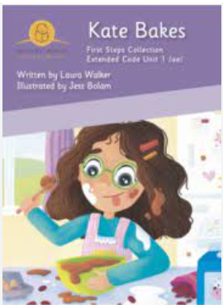

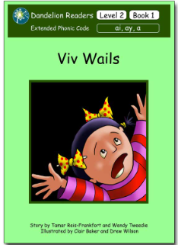
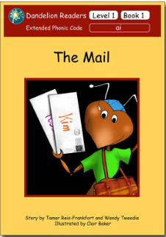
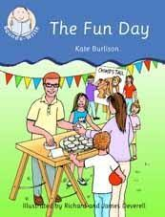
Our reading scheme
Books progress matching our phonics teaching – these will be decodable (can use phonics to read)
Please look after these ☺
Please also note children may read these books more than once

Slide 8
Reading at home
Children should read books 3 times.
Once to decode by practise blending and segmenting.
Twice for prosody and fluency.
Third for comprehension and expression.
This is essential!

Slide 9
Things to remember!
Books will be changed by the class teacher, by monitoring their progress and matching books to their phonic knowledge.
Your child will be given a reading record with their book, please make sure you record in the reading record when you have read with your child so we know they have been reading.
Books will be given out and collected in on a Monday and Friday – Please make sure they are always in your child's book bag.
Teachers will stamp acknowledging that you have read with your child.
Your comments are helpful and lovely to read!

Slide 10
Reading Races
Please use our reading races to encourage your child to read, sign off one circle EVERY TIME your child reads, once you have five completed, they will receive a book prize.
These will be tucked into your reading records and numbered.

Slide 11
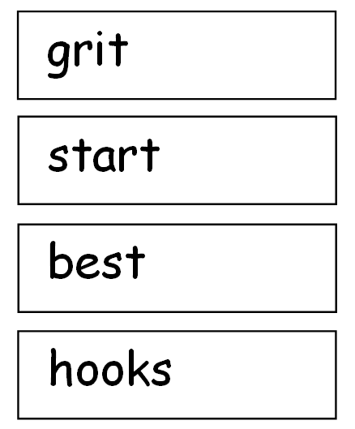
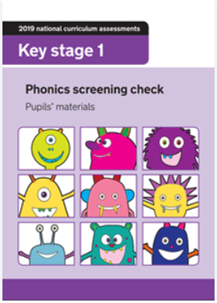
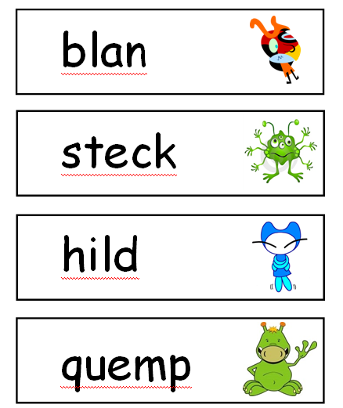
Year 1 Phonics Screening
Check of their phonic knowledge
40 words to read in 2 sections
Real words and ‘alien’ nonsense words
Roughly 5-10 minutes
Takes place in June

Slide 12
How can you help?
2 letters that make 1 sound = brown
3 letters that make 1 sound = night
Split 2 letters that make 1 sound - a consonant in between. spine = i-e
Break down polysyllabic words into syllables = fish bowl
Read, read, read
Encourage discussion around what sounds/graphemes they notice
Encourage children if they are unsure to ALWAYS ‘say the sound and read the word’

Slide 13
